Slide 1
Unit IV
Error Detection
and Correction
Vinit R Tribhuvan
vrt22.comp@coep.ac.in
1
Notes:
Data Communication

Slide 2
Errors in data transmission
Data can be corrupted during transmission.
A lot of applications require that errors be detected and corrected.
2
Notes:
Data Communication

Slide 3
Types of Errors
Single Bit
Multi Bit
Burst Error

Slide 4
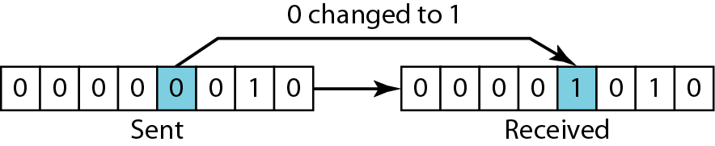
Single bit error

Slide 5
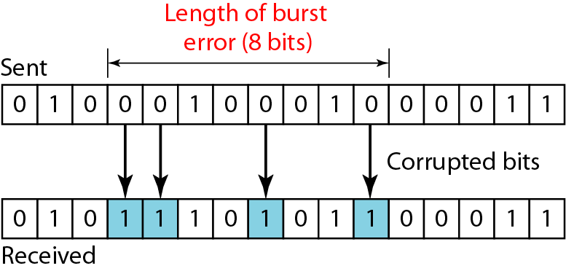
Burst error
A burst error means that 2 or more bits in the data unit have changed.

Slide 6
Redundancy
To be able to detect or correct errors, we need to send some extra bits with our data.
These redundant bits are added by the sender and removed by the receiver.

Slide 7
Detection v/s Correction
Is there a difference?

Slide 8
Detection v/s Correction
Is there a difference? CERTAINLY!
The correction of errors is more difficult than the detection.
In detection, only check is made if error is present? Answer is simple, yes or no.
In correction, once the check is made and error is detected, it also locates the error. Answer is additional information of location of error to perform correction.

Slide 9
Coding
Redundancy is achieved through various coding schemes.
We can divide coding schemes into two broad categories: block coding
To perform coding, we need encoding and decoding.
The receiver can detect error, if it follows these two conditions:
1. The receiver has (or can find) a list of valid codewords. 2. The original codeword has changed to an invalid one

Slide 10
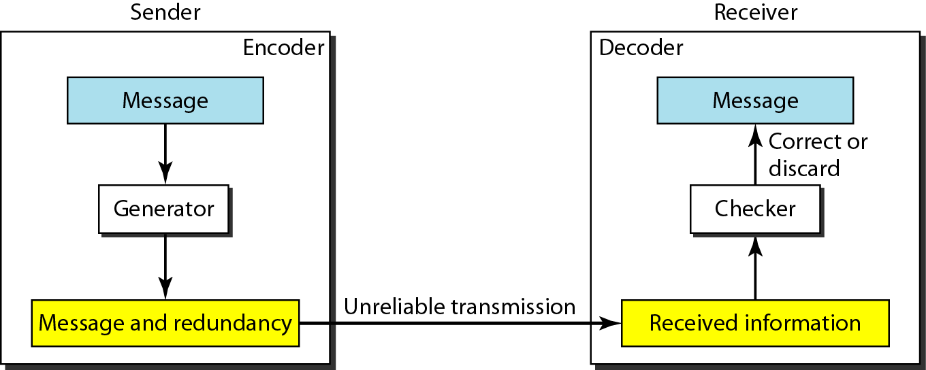
Encoder and Decoder

Slide 11
Block Coding
In block coding, we divide our message into blocks, each of k bits, called datawords.
We add r redundant bits to each block to make the length n = k + r.
The resulting n-bit blocks are called codewords.

Slide 12
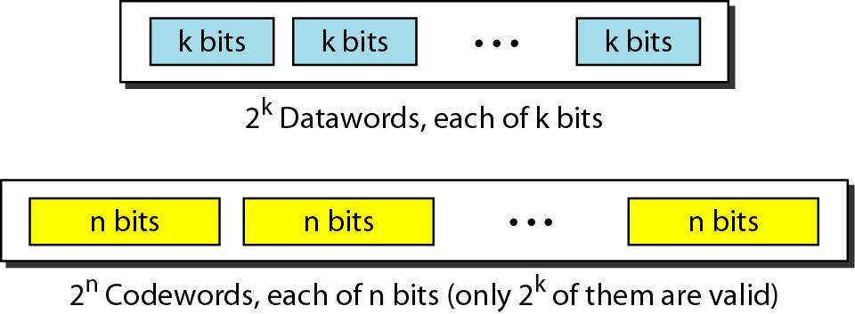
Datawords and codewords in block coding

Slide 13
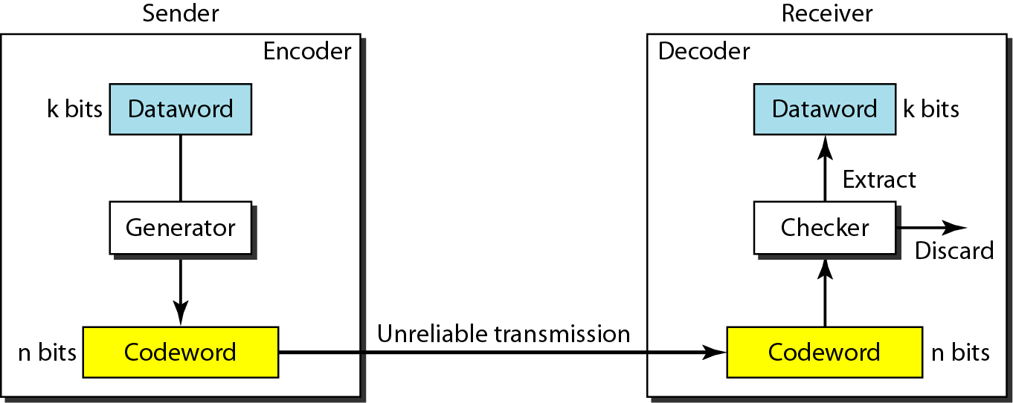
Error detection in block coding

Slide 14
Example

Slide 15
Example
Let us assume that k = 2 and n = 3. Table 10.1 shows the list of datawords and codewords. Later, we will see how to derive a codeword from a dataword.
Assume the sender encodes the dataword 01 as 011 and sends it to the receiver. Consider the following cases:
1. The receiver receives 011. It is a valid codeword. The receiver extracts the dataword 01 from it.
2. The codeword is corrupted during transmission, and 111 is received. This is not a valid codeword and is discarded.
3. The codeword is corrupted during transmission, and 000 is received. This is a valid codeword. The receiver incorrectly extracts the dataword 00. Two corrupted bits have made the error undetectable.

Slide 16
IMPORTANT
An error-detecting code can detect only the types of errors for which it is designed; other types of errors may remain undetected.

Slide 17
Hamming Distance
The Hamming distance between two words (of the same size) is the number of
differences between the corresponding bits.
The Hamming distance between two words x and y as d(x, y).
The Hamming distance can easily be found if we apply the XOR operation on the two words and count the number of 1s in the result.

Slide 18
Example
Let us find the Hamming distance between two pairs of words.
The Hamming distance d(000, 011) is 2 because (000 ⊕ 011) is 011 (two 1s).
The Hamming distance d(10101, 11110) is 3 because (10101 ⊕ 11110) is 01011 (three 1s).

Slide 19









Minimum Hamming Distance
If s errors occur during transmission, the Hamming distance between the sent codeword and received codeword is s.
If our system is to detect up to s errors, the minimum distance between the valid
codes must be (s + 1), so that the received codeword does not match a valid codeword.
if the minimum distance between all valid codewords is (s + 1), the received codeword cannot be erroneously mistaken for another codeword.
Although a code with dmin = s + 1 may be able to detect more than s errors in some special cases, only s or fewer errors are guaranteed to be detected.

Slide 20
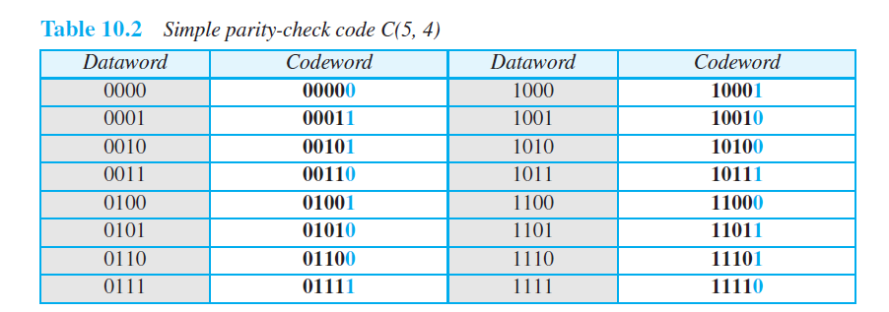

Parity-Check Code
linear block code.
a k-bit dataword is changed to an n-bit codeword where n = k + 1
The extra bit, called the parity bit, is selected to make the total number of 1s in the codeword even.

Slide 21
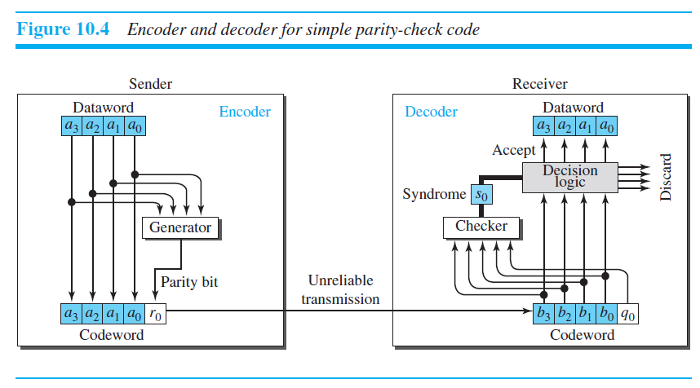

Slide 22
Encoder
The encoder uses a generator that takes a copy of a 4-bit dataword (a0, a1, a2, and a3) and generates a parity bit r0.
The dataword bits and the parity bit create the 5-bit codeword. The parity bit that is added makes the number of 1s in the codeword even.
This is normally done by adding the 4 bits of the dataword (modulo-2);
The result is the parity bit.
r₀ = ∑ a_{i} mod 2

Slide 23
If the number of 1s is even, the result is 0; if the number of 1s is odd, the result is 1.
The sender sends the codeword, which may be corrupted during transmission.
The receiver receives a 5-bit word. The checker at the receiver does the same thing as the generator in the sender with one exception: The addition is done over all 5 bits.
Result is called the syndrome, is just 1 bit. The syndrome is 0 when the number of 1s in the received codeword is even; otherwise, it is 1.
s₀ = ∑ b_{i} + q₀ mod 2

Slide 24
If the syndrome is 0, there is no detectable error in the received codeword; the data portion of the received codeword is accepted as the dataword;
if the syndrome is 1, the data portion of the received codeword is discarded.
The dataword is not created.

Slide 25
Example
Assume the sender sends the dataword 1011. The codeword created from this dataword is 10111, which is sent to the receiver. The following five cases.
No error occurs; the received codeword is 10111. The syndrome is 0. The dataword 1011 is created.
One single-bit error changes a1. The received codeword is 10011. The syndrome is 1. No dataword is created.
One single-bit error changes r0. The received codeword is 10110. The syndrome is 1. No dataword is created. Note that although none of the dataword bits are corrupted, no dataword is created because the code is not sophisticated enough to show the position of the corrupted bit.

Slide 26
4. An error changes r0 and a second error changes a3. The received codeword is 00110. The syndrome is 0. The dataword 0011 is created at the receiver. Note that here the dataword is wrongly created due to the syndrome value. The simple parity-check decoder cannot detect an even number of errors. The errors cancel each other out and give the syndrome a value of 0.
5. Three bits—a3, a2, and a1—are changed by errors. The received codeword is 01011. The syndrome is 1. The dataword is not created. This shows that the simple parity check, guaranteed to detect one single error, can also find any odd number of errors.

Slide 27
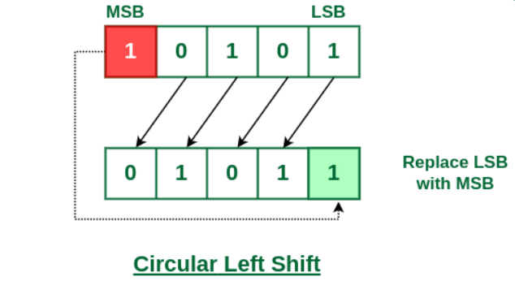
Cyclic codes
In a cyclic code, if a codeword is cyclically shifted (rotated), the result is another codeword.
For example, if 1011000 is a codeword and we cyclically left-shift, then 0110001 is also a codeword

Slide 28
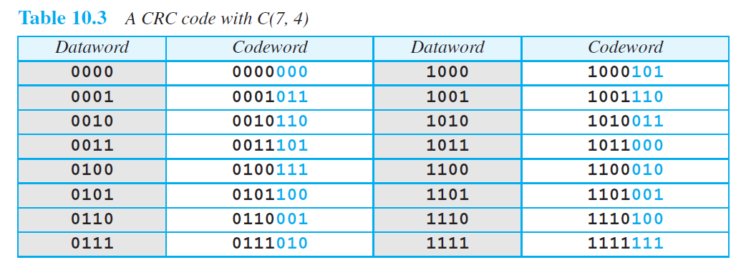


Cyclic Redundancy Check (CRC)

Slide 29
Encoding
the dataword has k bits (4 here); the codeword has n bits (7 for instance).
The size of the dataword is augmented by adding n − k (3 for instance) 0s to the right-hand side of the word.
n-bit result is fed into the generator
The generator uses a divisor of size n − k + 1 (4 for instance)
The generator divides the augmented dataword by the divisor (modulo-2 division).
The quotient of the division is discarded.
the remainder (r2r1r0) is appended to the dataword to create the codeword

Slide 30
Decoding
The decoder receives the codeword
A copy of all n bits is fed to the checker
The remainder of the checker is a syndrome of n − k (3 for instance) bits
If the syndrome bits are all 0s, the 4 leftmost bits of the codeword are accepted as the dataword
otherwise, the 4 bits are discarded (error).

Slide 31
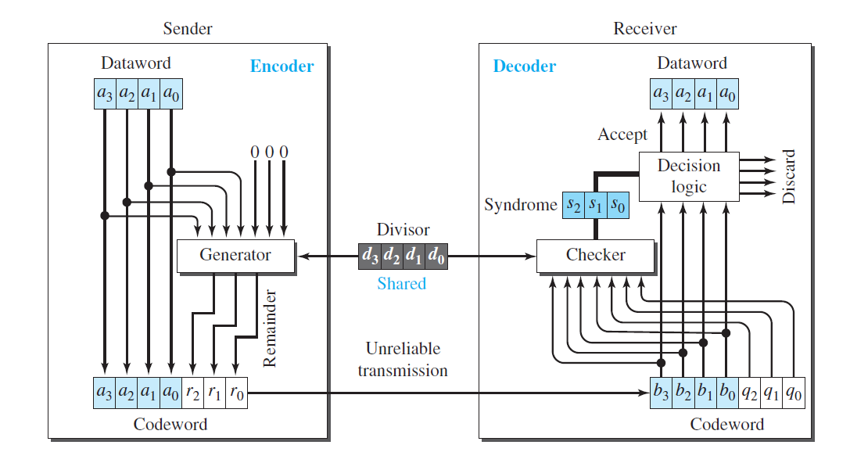

Slide 32
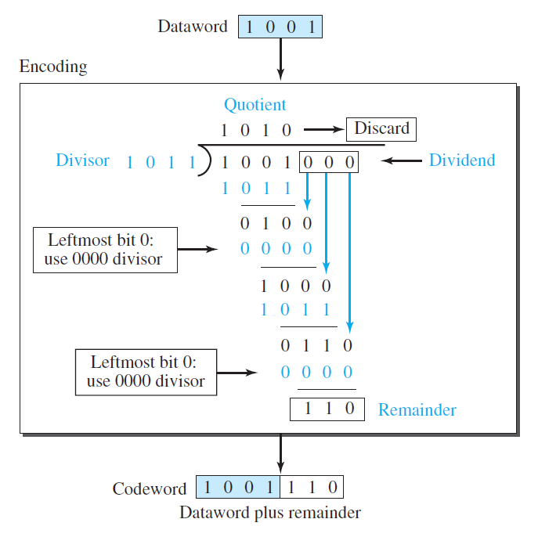
Division in CRC encoder

Slide 33
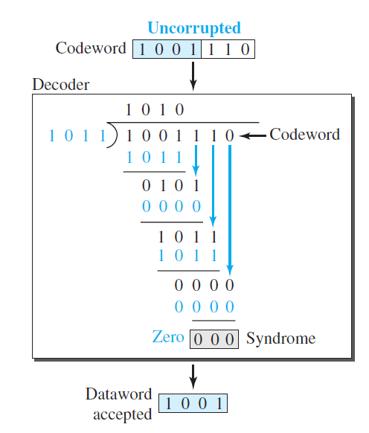
Division in CRC Decoder

Slide 34
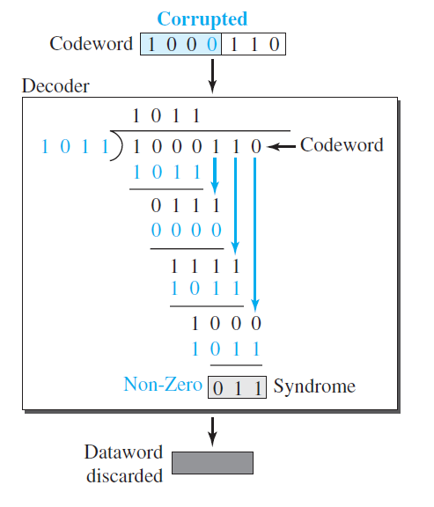
Division in CRC Decoder

Slide 35
Checksum
Checksum is an error-detecting technique that can be applied to a message of any length.
At the source, the message is first divided into m-bit units
The generator then creates an extra m-bit unit called the checksum
At the destination, the checker creates a new checksum from the combination of the message and sent checksum
If the new checksum is all 0s, the message is accepted, otherwise discarded.

Slide 36
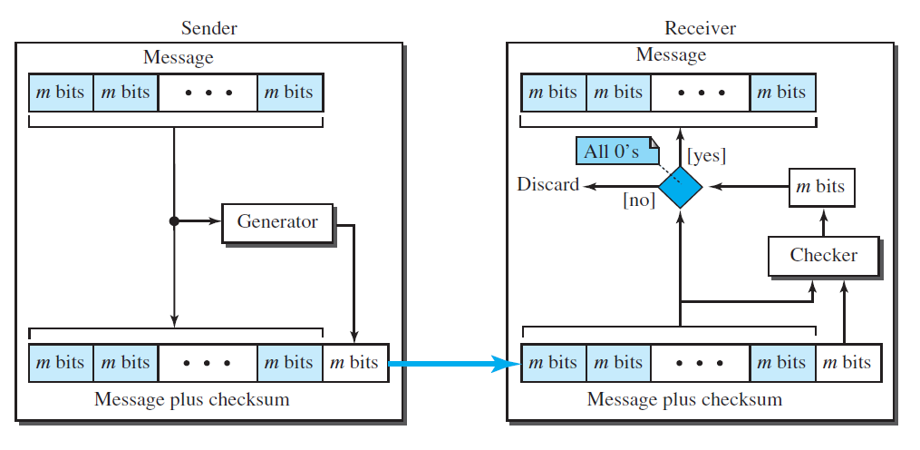
Checksum

Slide 37
Example
For example, if the set of numbers is (7, 11, 12, 0, 6), we send (7, 11, 12, 0, 6, 36), where 36 is the sum of the original numbers.
The receiver adds the five numbers and compares the result with the sum.
If the two are the same, the receiver assumes no error, accepts the five numbers, and discards the sum.
Otherwise, there is an error somewhere and the message is not accepted.

Slide 38
Example
The sender adds all five numbers in one’s complement to get the sum = 6.
The sender then complements the result to get the checksum = 9, which is 15- 6. Note that 6 = (0110)₂ and 9 = (1001)₂; they are complements of each other.
The sender sends the five data numbers and the checksum (7, 11, 12, 0, 6, 9). If there is no corruption in transmission, the receiver receives (7, 11, 12, 0, 6, 9) and adds them in one’s complement to get 15.
The sender complements 15 to get 0. This shows that data have not been corrupted.

Slide 39
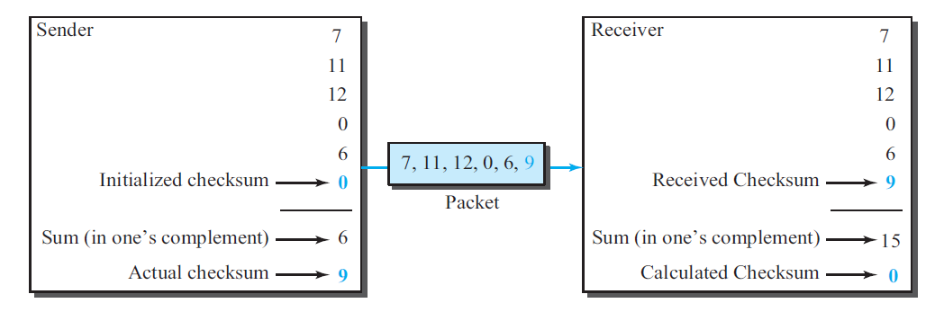

Slide 40


Sender
Suppose data is 01110011, we divide the data into 4 bit chunks. So, n = 4. Since total number of digits in data is 8. So, there will be 2 chunks of data ( 0111 and 0011 ).
Adding both chunks –
0 1 1 1 0 0 1 1 ——— 1 0 1 0 ——— Result (1010) has no carry bit. Now, take 1’s compliment. It will be 0101. So, checksum = 0101. The data that will be sent = 011100110101

Slide 41

Receiver
So, after receiving result, the result will be divided into chunks of 4 bit. So, chunks will be 0111, 0011 and 0101.
Adding all chunks using 1’s complement –
0 1 1 1 0 0 1 1 0 1 0 1 ————– 1 1 1 1 ————– Now, taking the compliment of the result(1111), we will get 0000. So, there is no error.

Slide 42
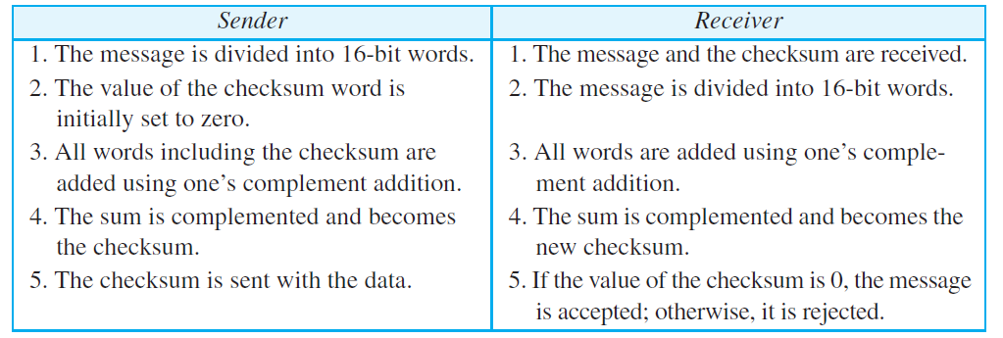

Internet checksum
Traditionally, the Internet has used a 16-bit checksum.

Slide 43
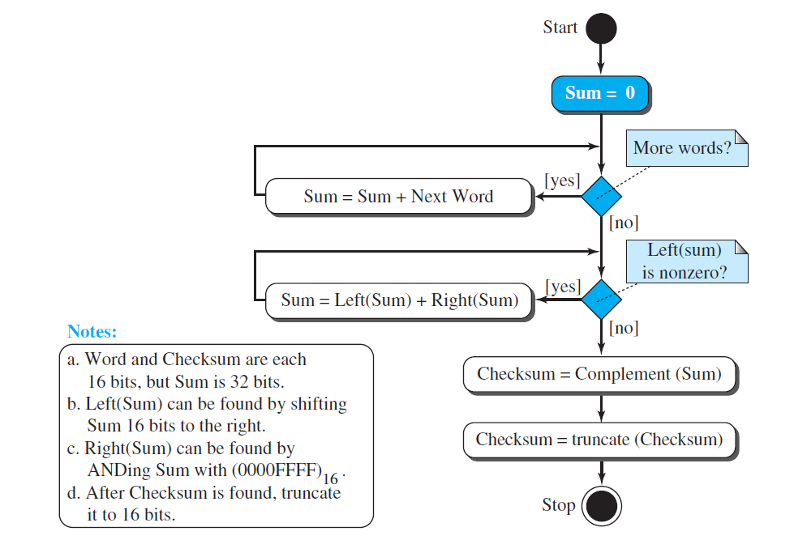
Algorithm

Slide 44
The 8-bit Fletcher is calculated over data octets (bytes) and creates a 16-bit checksum. 16-bit Fletcher, calculates on 16-bit data items and creates a 32-bit checksum.
In 8 bit algo., The calculation is done modulo 256 (2⁸)
The algorithm uses two accumulators, L and R.
The first simply adds data items together; the second adds a weight to the calculation.
The 16-bit Fletcher checksum is similar to the 8-bit Fletcher checksum, but it is
calculated over 16-bit data items and creates a 32-bit checksum.
The calculation is done modulo 65,536.

Slide 45
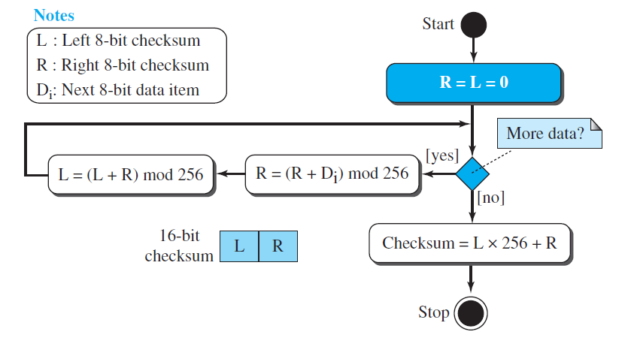
Fletcher checksum

Slide 46
The Adler checksum is a 32-bit checksum.
It is similar to the 16-bit Fletcher with three differences.
First, calculation is done on single bytes instead of 2 bytes at a time.
Second, the modulus is a prime number (65,521) instead of 65,536.
Thirdly, L is initialized to 1 instead of 0.

Slide 47
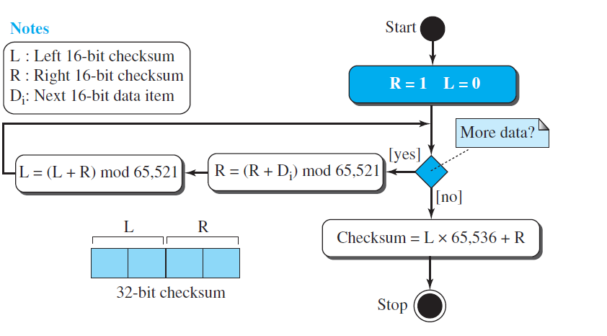
Adler checksum

Slide 48
Forward Error Correction
Hamming Distance
XORing
Chunk Interleaving
Combining Hamming Distance and Interleaving
Compounding High- and Low-Resolution Packets

Slide 49













Hamming Distance
We said that to detect s errors, the minimum Hamming distance should be
dmin = s + 1
However, to detect t errors, we need to have dmin = 2t + 1.
For example, if we want to correct 10 bits in a packet, we need to make the minimum hamming distance 21 bits.
Most of the time we cannot afford such a redundancy.

Slide 50
XORing
Use the following property of XOR
if we apply the exclusive OR operation on N data items (P1 to PN), we can recreate any of the data items by exclusive-ORing all of the items, replacing the one to be created by the result of the previous operation (R).
we can divide a packet into N chunks, create the exclusive OR of all the chunks and send N + 1 chunks.

Slide 51
If any chunk is lost or corrupted, it can be created at the receiver site.
If N = 4, it means that we need to send 25 percent extra data and be able to correct the data if only one out of four chunks is lost.

Slide 52

Chunk Interleaving
Assume that one chunk of data is missing in each packet.
we can divide each packet into 5 chunks (normally the number is much larger).
We can then create data chunk by chunk (horizontally), but combine the chunks into packets vertically.
each packet sent carries a chunk from several original packets.
If the packet is lost, we miss only one chunk in each packet, which is normally acceptable in multimedia communication

Slide 53
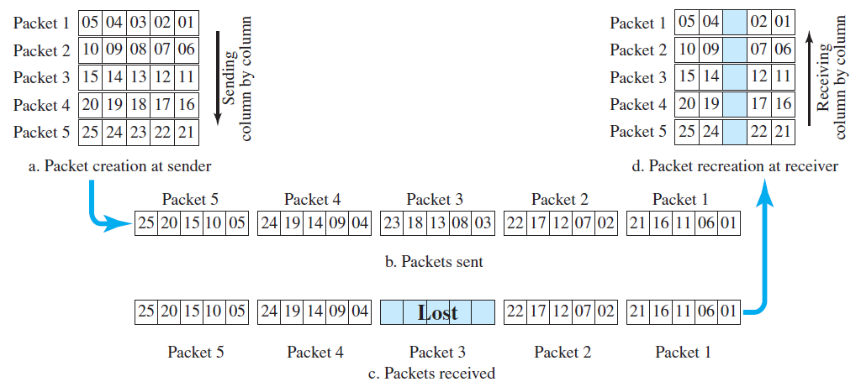

Slide 54



Compounding High- and Low-Resolution Packets
Create a duplicate of each packet with a low-resolution redundancy and combine the redundant version with the next packet.
We can create four low-resolution packets out of five high-resolution packets and send them as shown in the figure.
If a packet is lost, we can use the low-resolution version from the next packet.
In this method, if the last packet is lost, it cannot be recovered, but we use the low-resolution version of a packet if the lost packet is not the last one.
The audio and video reproduction does not have the same quality, but the lack of quality is not recognized most of the time.

Slide 55
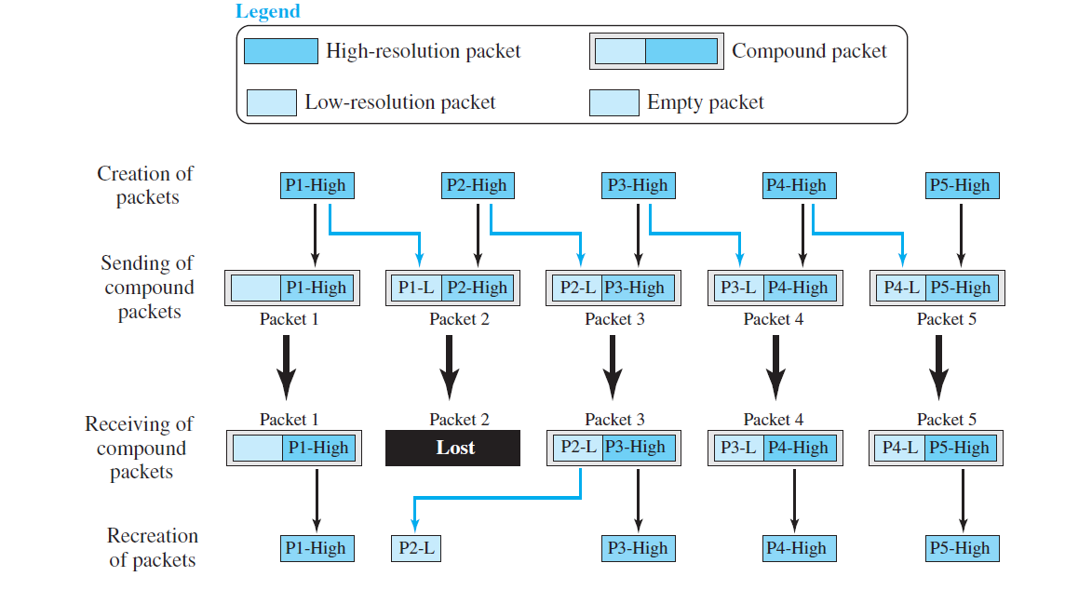
Compounding High- and Low-Resolution Packets

Slide 56
Exercise
A category of error detecting (and correcting) code, called the Hamming code, is a code in which dmin = 3. This code can detect up to two errors (or correct one single error). In this code, the values of n, k, and r are related as: n = 2r − 1 and k = n − r. Find the number of bits in the dataword and the codewords if r is 3.

Slide 57
Exercise
In the interleaving approach to FEC, assume each packet contains 10 samples from a sampled piece of music. Instead of loading the first packet with the first 10 samples, the second packet with the second 10 samples, and so on, the sender loads the first packet with the odd-numbered samples of the first 20 samples, the second packet with the even-numbered samples of the first 20 samples, and so on. The receiver reorders the samples and plays them. Now assume that the third packet is lost in transmission. What will be missed at the receiver site?

